Slide 1
Impulse Excitation Technique
Impulse Excitation Testing of Green Ceramics During Firing Paul Bosomworth President/CEO BuzzMac International, LLC
Contact Info
Email: paul@buzzmac.com
Ph: +1 (603) 835-3180

Slide 2
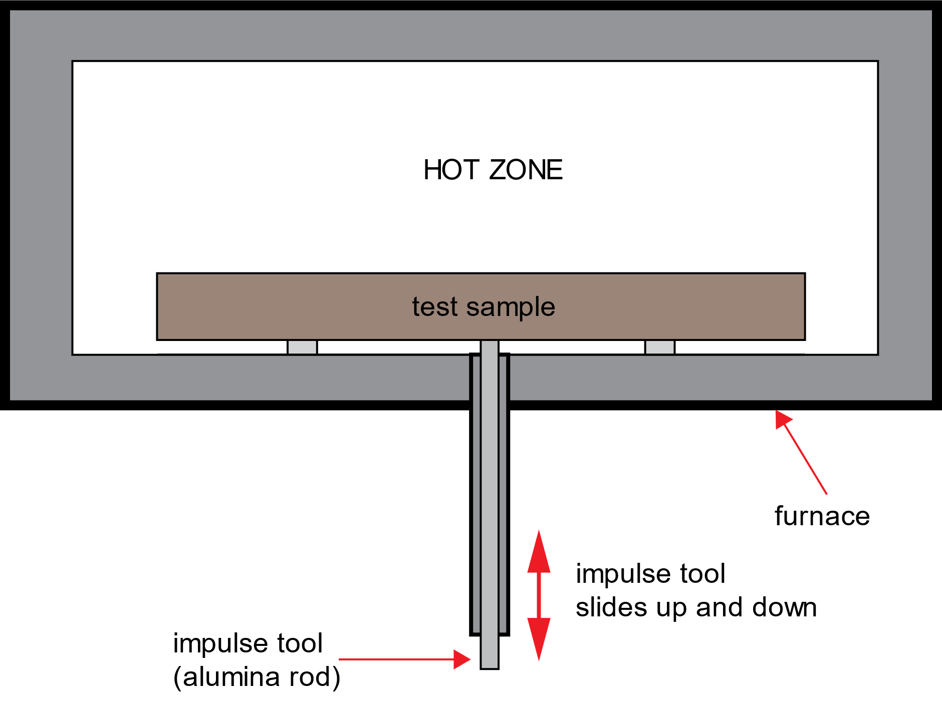
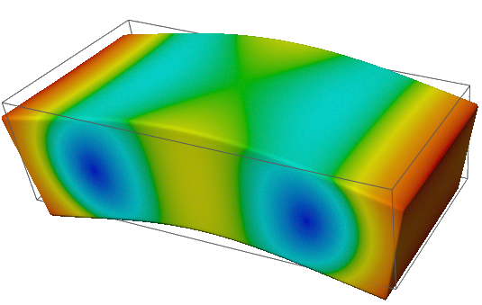
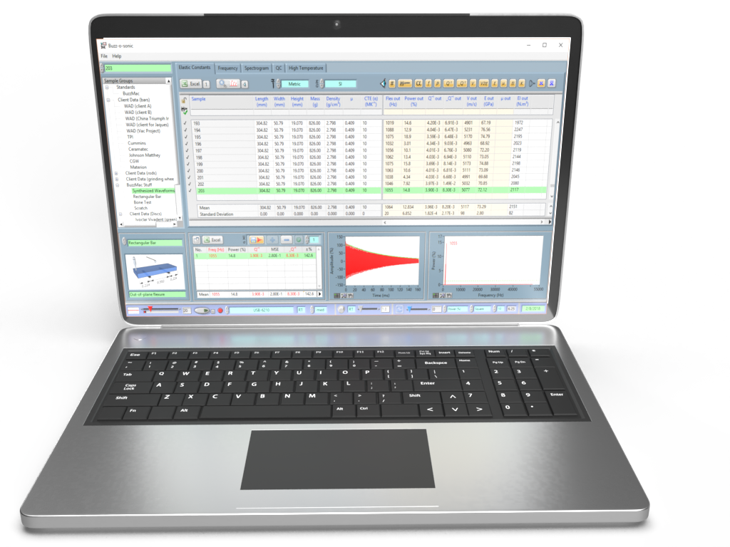
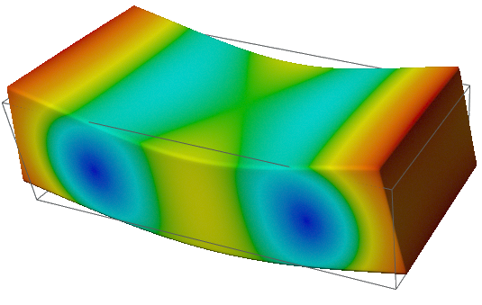
Impulse Excitation Technique (IET)* at High Temperature
TAP Ceramic
MEASURE
VIBRATIONS
RECORD & ANALYSE
(damping/elastic properties)
*also known as ping test, resonant vibration, impact acoustic resonance, eigen frequency method…

Slide 3
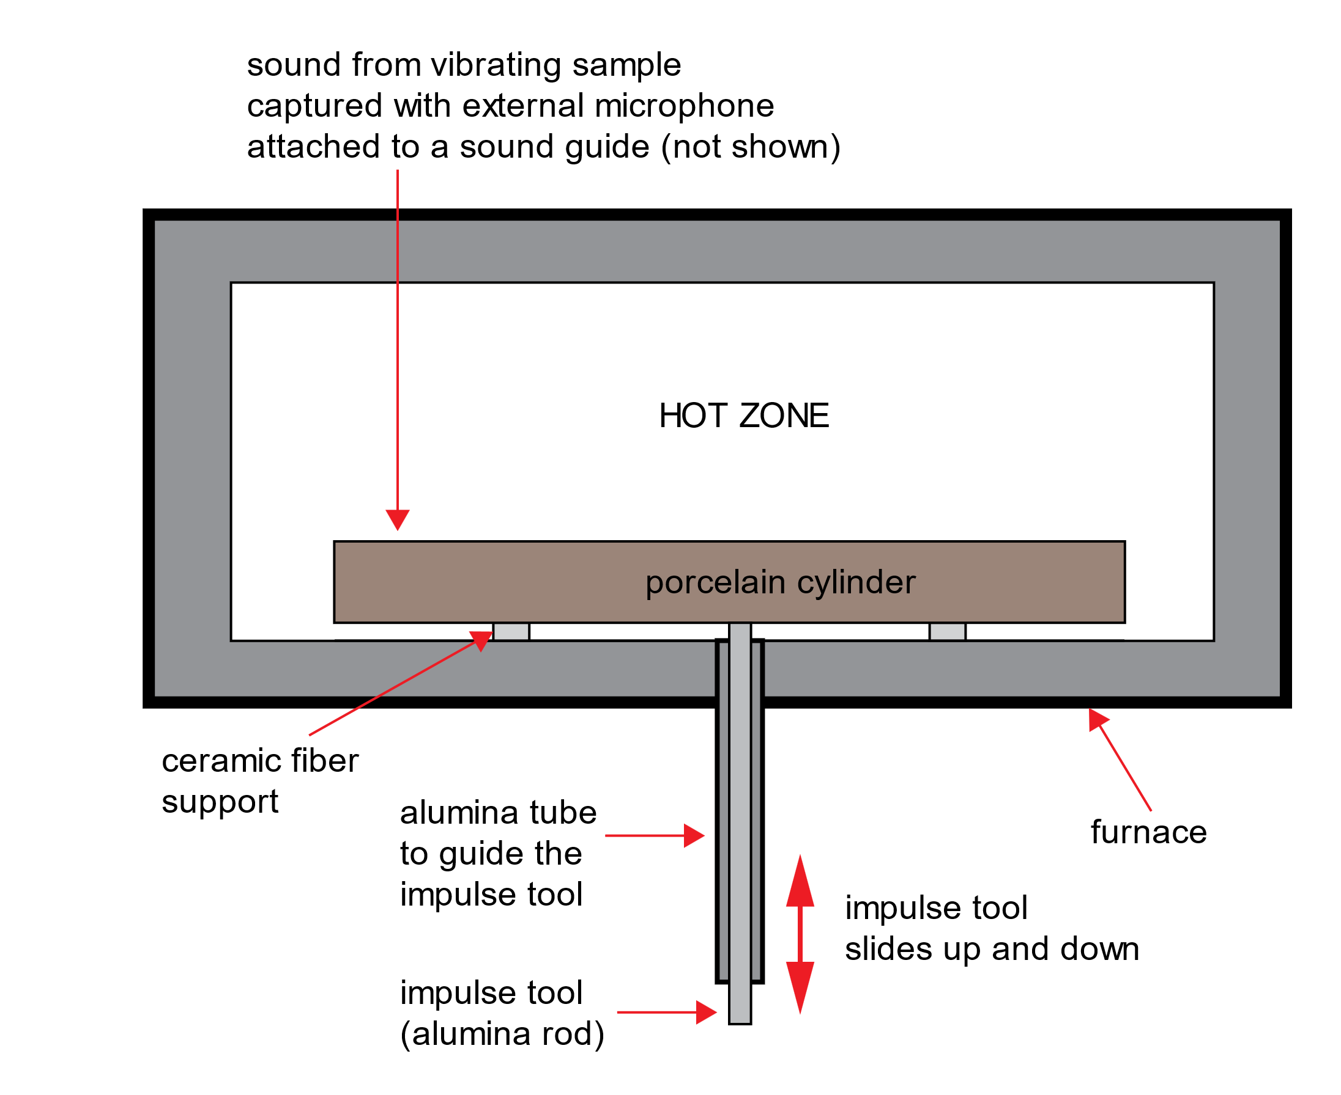
Introduction
Only nondestructive testing (NDT) methods can be used to monitor the elastic properties of green ceramics as they are being fired. The impulse excitation technique (IET) was used to relate changes in elastic properties of a green quartz sample to the phase changes occurring during firing¹. The setup is shown in figure 1 below.
The sample was an extruded cylinder (φ11.73 mm x 113.97 mm) of a porcelain mixture (50 wt% kaolin, 25 wt% quartz and 25 wt% feldspar).
The sample was heated to ~1100 °C at a rate of 5 °C/min in air.
Figure 1: High temperature setup
Paul A. Bosomworth, " Monitoring the Elastic Properties of Green Ceramics during Firing," Ceramic Industry (February 2016)

Slide 4
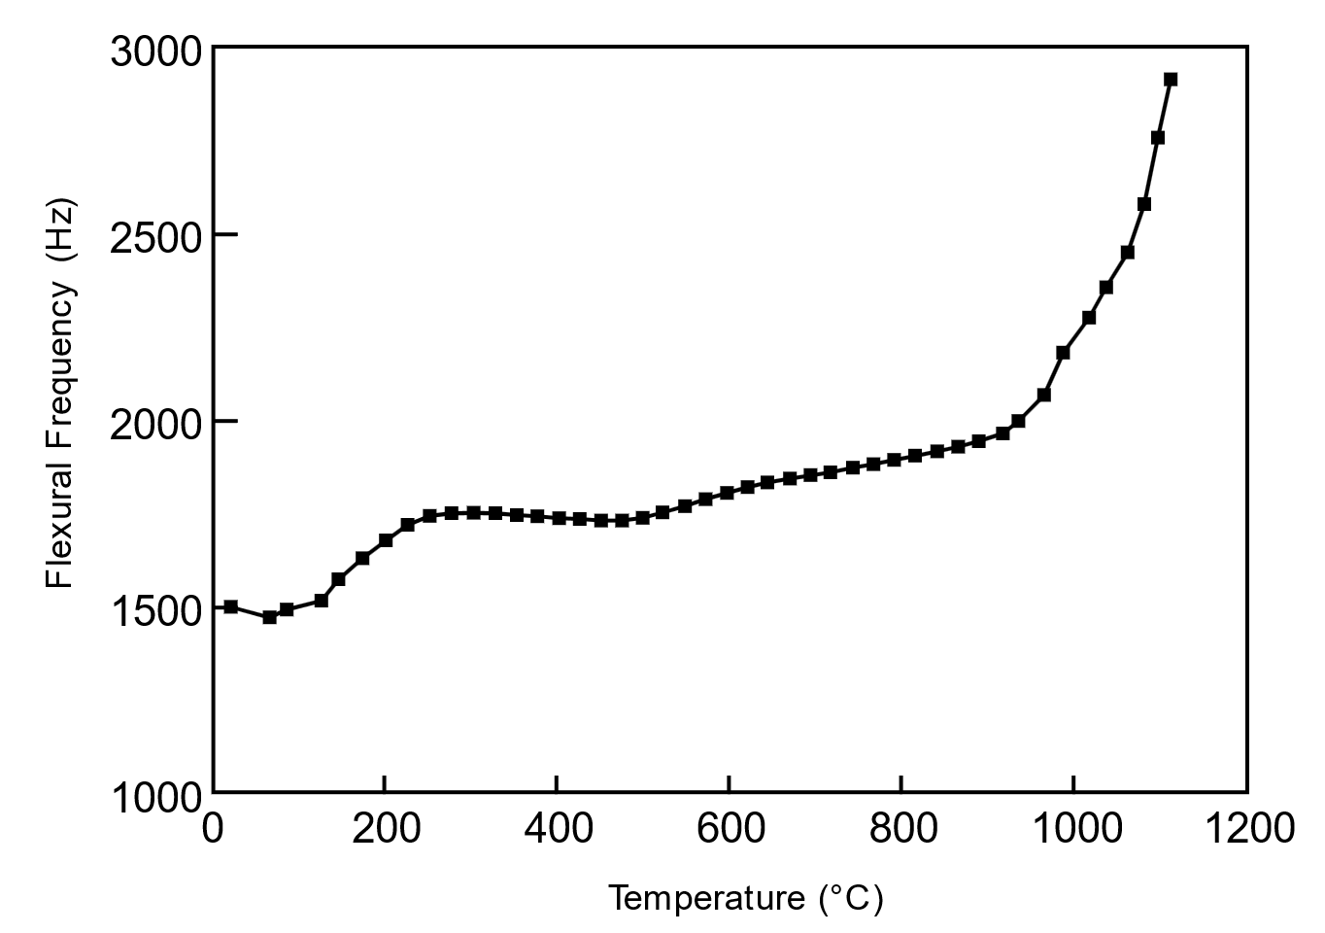
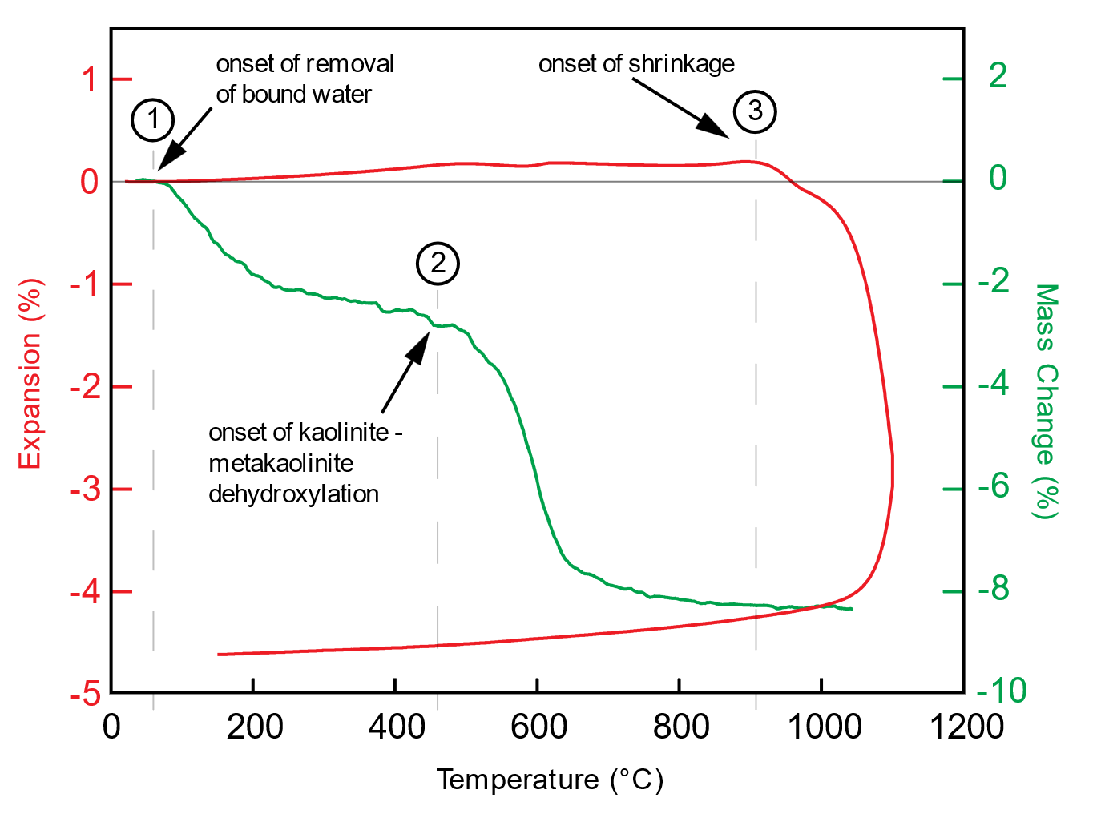
Results
The flexural frequency can be compared to some results from thermal analyses^{1,2}.
Figure 2: Flexural frequency vs. temperature
Figure 3: Thermal analyses
1. Igor Stubna, Frantisek Chmelık, Anton Trnık, Josef Pesicka, “Creation of microcracks in porcelain during firing,” J Eur Ceram Soc. 31, pp. 2205–2209 (2011)
2. Igor Stubna, Frantisek Chmelık, Anton Trnık, Peter Sin, “Acoustic emission study of quartz porcelain during heating up to 1150 °C,” Ceram Int, 38 pp. 6919–6922 (2012)

Slide 5
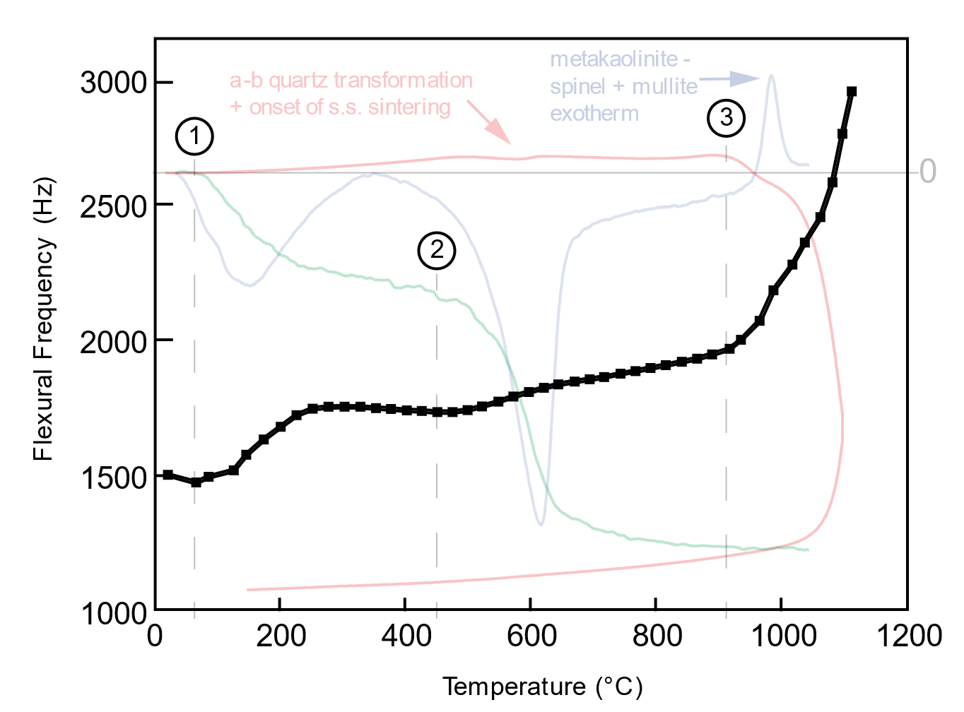
Discussion of Results
By combining figures 2 and 3 and adding DTA data in figure 4, three main regions of interest are revealed:
Water physically bound to the pore surfaces in the sample begins to be driven off at ~ 50 °C (TGA curve).
The kaolinite in the green body transforms into metakaolinite over the temperature range of 400-700 °C. Dehydroxilation takes place at ~420°C (DTA curve) with a concomitant mass loss (TGA curve).
The sample begins to shrink significantly above 893 °C (TDA curve).
Figure 4
The initial rise in frequency matches the onset of water loss (1), the second one matches the onset of the kaolinite –metakaolinite dihydroxylation (2), and the final and rapid frequency rise matches the sample shrinkage (3). Sintering mechanisms will lead to more shrinkage and an increase in the flexural frequency. Other effects can be seen in the frequency curve: an inflection can be seen to match the α-β quartz inversion shown in the TDA/DTA curves. Solid state sintering, which occurs above ~600 °C also gives rise to an increase in the flexural frequency in addition to that due to mass loss. Microcracking from phase changes etc. also affects the frequency curve.

Slide 6
Conclusions and Comments
IET is ideally suited for measuring the changes in elastic properties during firing
IET can be used over a variety of testing environments (high/low temperatures, humidity…)
IET is fast, efficient and relatively low cost compared to destructive mechanical testing
IET is suited to R&D, QC/QA…
Any question or comments, please contact me on linkedin.com/in/paul-bosomworth-78151514

